Slide 1



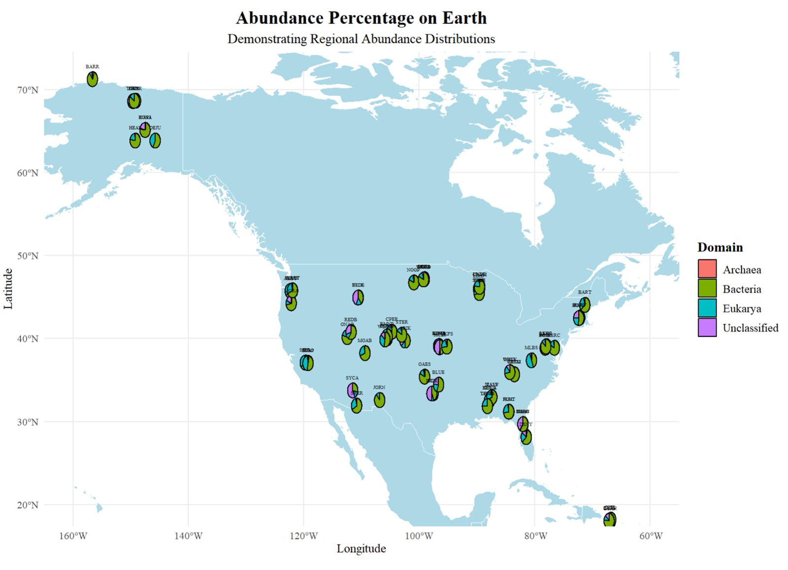
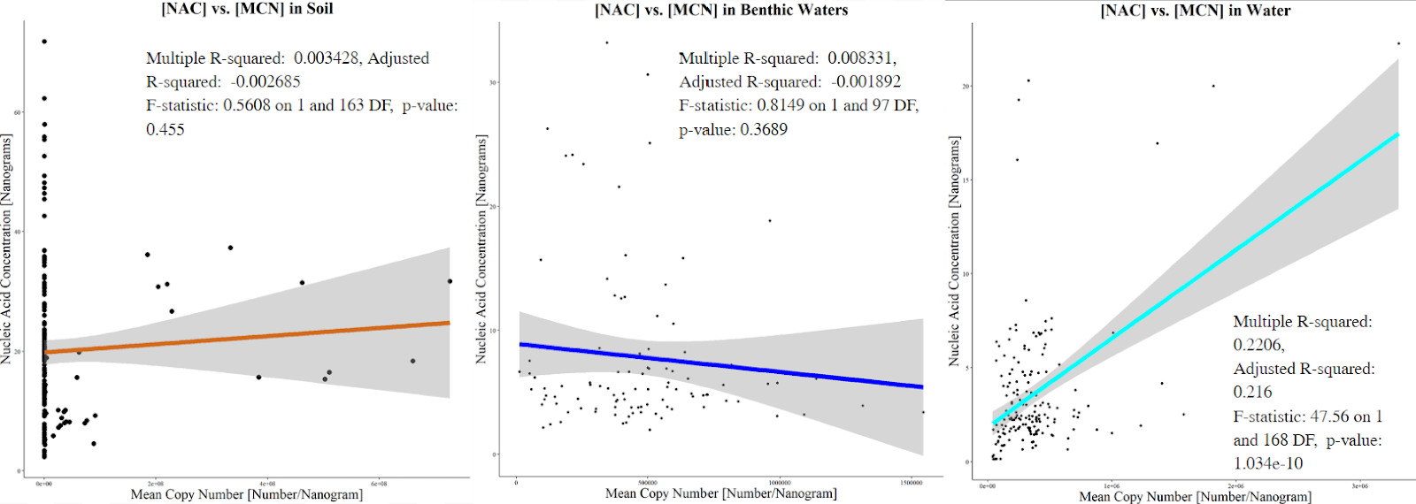
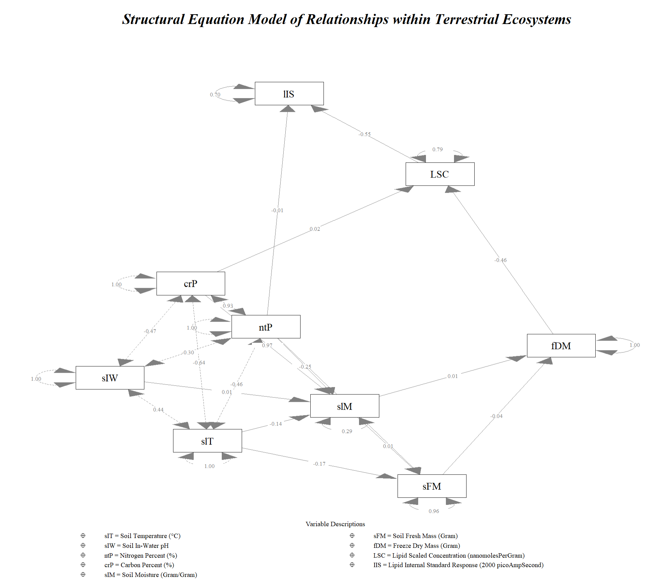
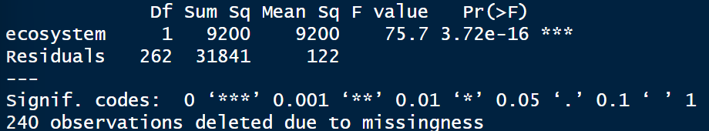
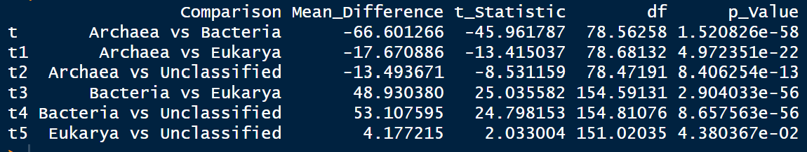
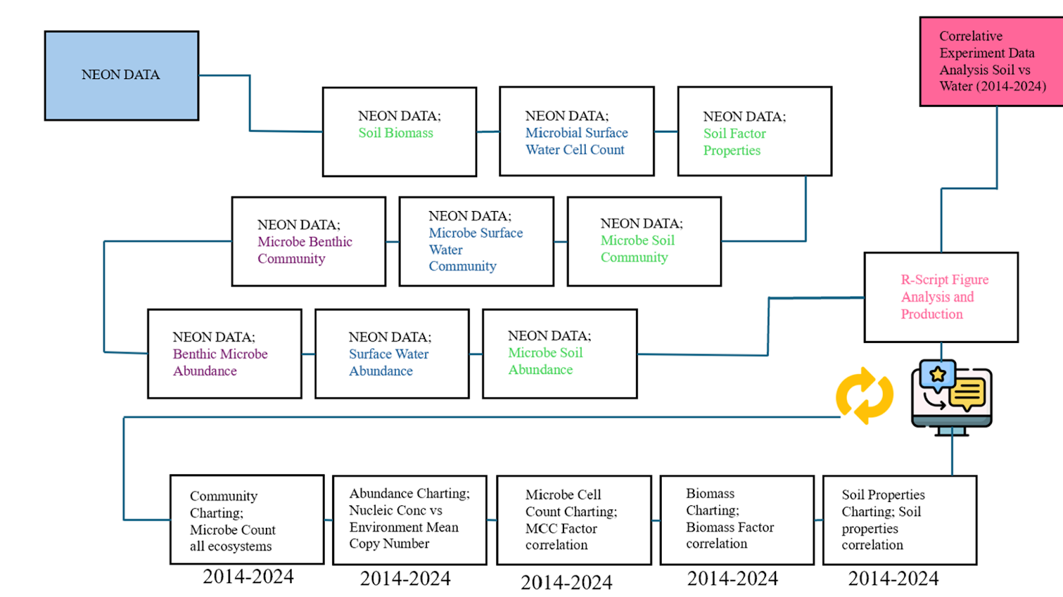
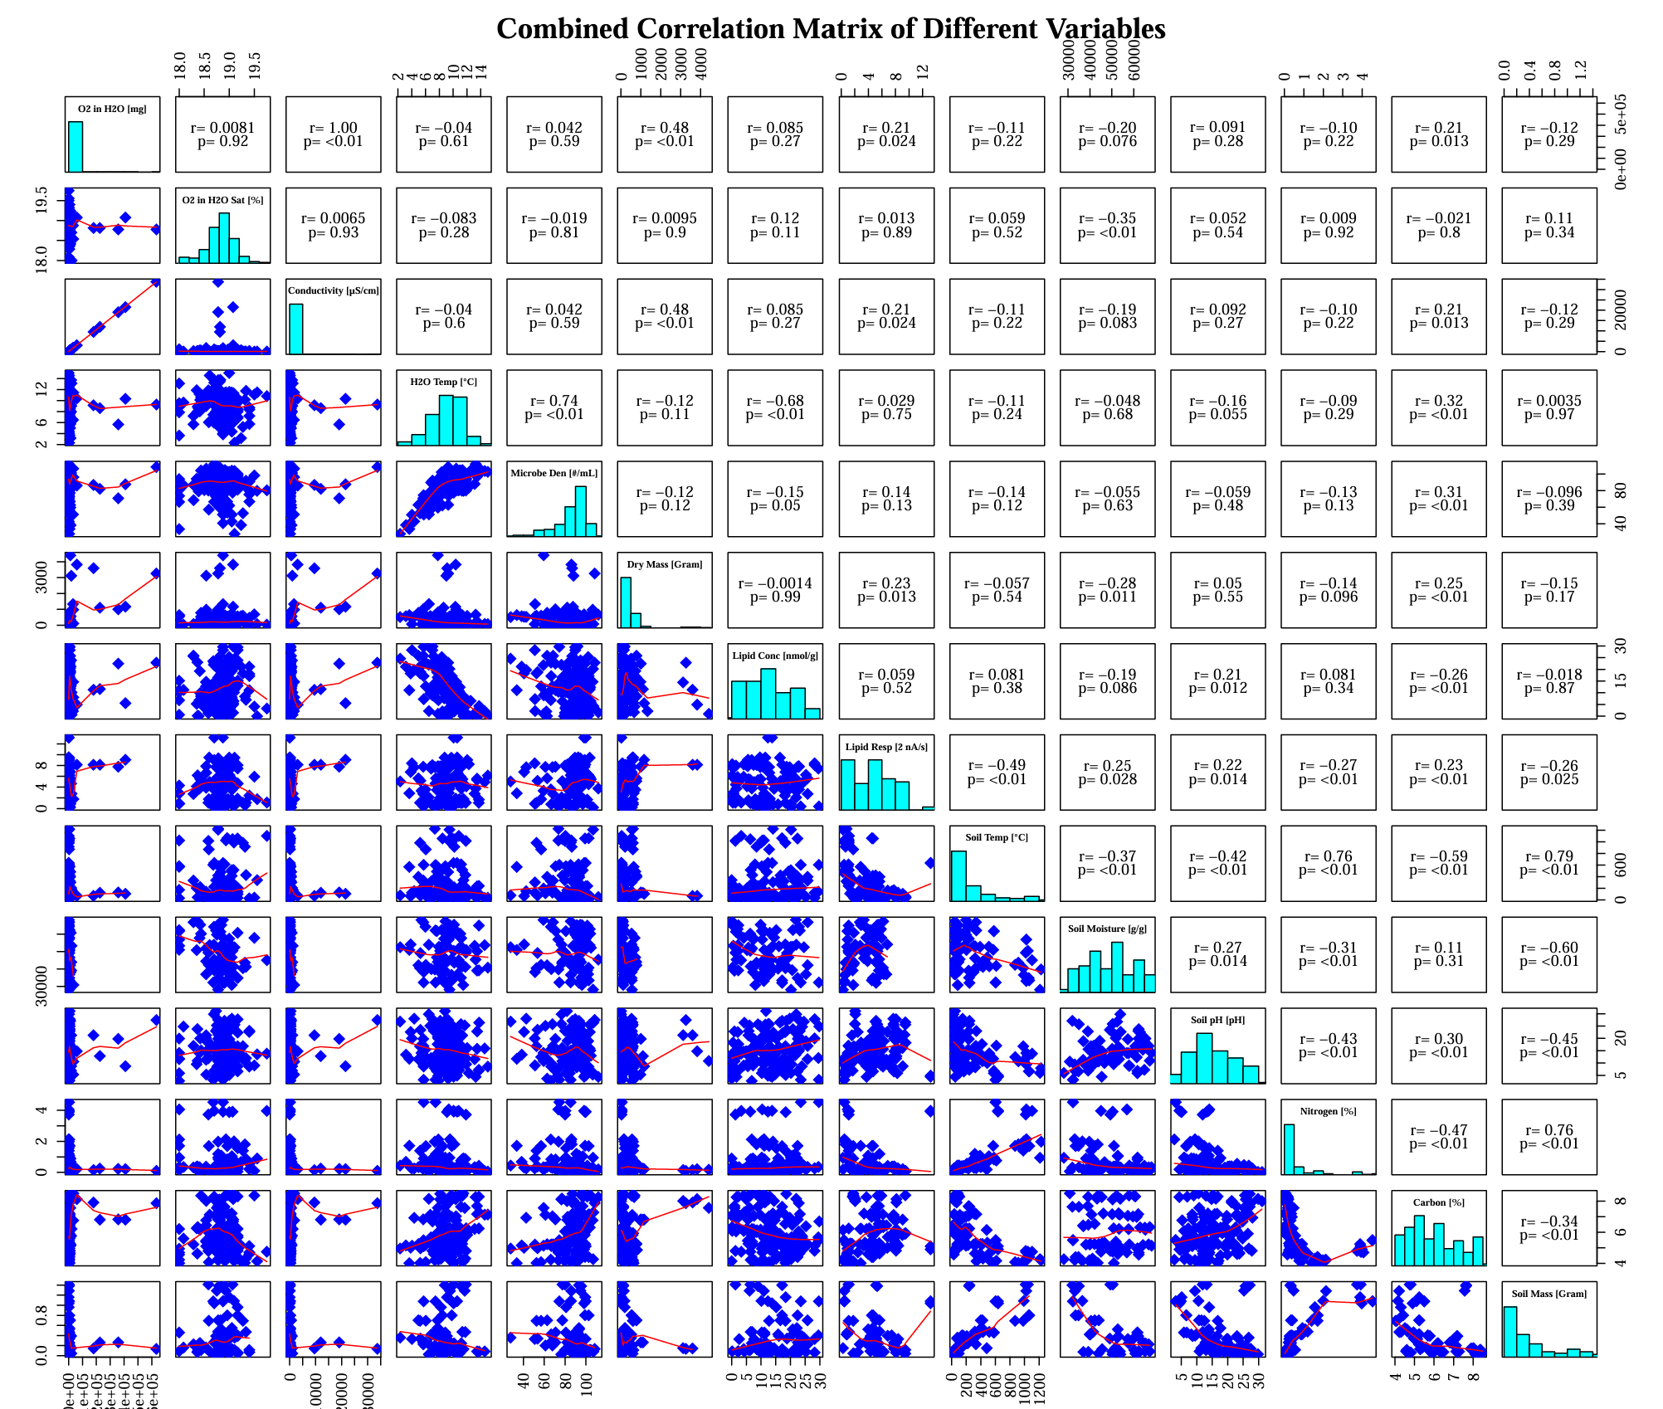
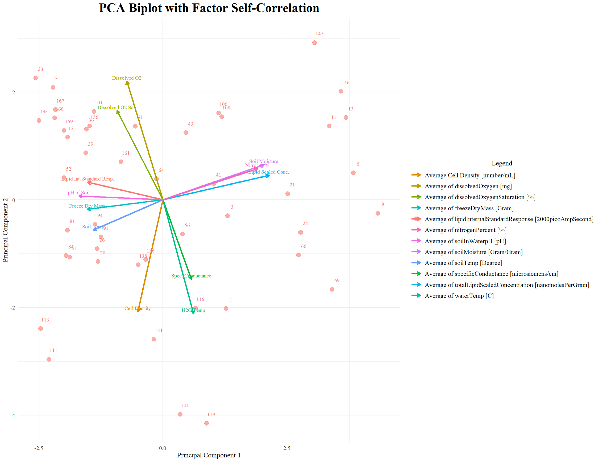
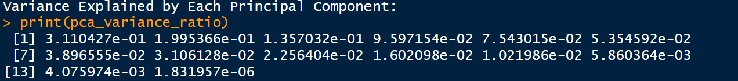
Data integration to investigate Microbial Abundance in Terrestrial and Aquatic Ecosystems and its Causes
Contact Information:
Email: lsai2907@sdsu.edu
Phone Number: (858)-444-0671
Best reached by email
Leo Sai¹ , David Lipson¹, Xiaofeng Xu¹
1. Biology Department, San Diego State University, San Diego, CA, USA
Background
Results
Significance Statement:
Aquatic and terrestrial microbes are the drivers and indicators of climate change by taking advantage of the acceleration of factors that effect biomechanical feedback loops which can be used in the advancements in green microbiology to sustain and mitigate climate change.
Hypothesis:
There will be significant correlation to Specific Conductance, O2 saturation, and moisture with aquatic and terrestrial ecosystems that are major contributors for the decline in microbial communities.
Based on an ANOVA test between soil, benthic, and water NAC and MCN display a p-value of 3.72e-16 which indicates a significant correlation rejecting the null hypothesis
Therefore, there is no correlation between the three different ecosystems to their corresponding factors of NAC and MCN.
Individually, there is only a correlation between NAC and MCN in surface level water ecosystems due to the p-value being 1.034e-10, rejecting the null hypothesis that is there is no correlation between NAC and MCN in surface level water ecosystems.
Methodology
Based on visual representations within the map, it shows that between the various types of classifications in microorganisms across the span of the US there is a large percentage in abundance of bacteria communities.
Based on an Independent t-test, it shows that all comparisons of locations whether it be longitudinal or horizontal of US within the archaea, bacteria, eukarya, and unclassified are significantly correlated as all p-values are lower than 0.05 in all aspects, rejecting the null hypothesis.
The SEM illustrates strong relation between McD and A_C (1.00), supporting the link between specific conductance with Microbial Cell Density. Same with Soil factors (SIP) with terrestrial abiotic factors.
Interestingly, lipid concentration is directly related to terrestrial abiotic factors but indirectly to aquatic ones. Water temperature shows weak relations with aquatic ecosystems.
Other abiotic factors in figures are also supported by the SEM, with values above 0.73 for their respective ecosystem.
Conclusion
The study aims to explore the correlation between microorganisms and environmental factors like temperature, soil composition, pH, and moisture, using NEON Laboratories data to advance Green Microbiology for climate sustainability.
Microorganisms are crucial in biomechanical processes that affect climate change, with alarming declines in microbial populations and diversity in both aquatic and terrestrial ecosystems.
Water temperature and specific conductance are significant drivers of the carbon cycle, acting as either accelerants or deterrents depending on their levels.
Soil moisture and temperature are critical to the nitrogen cycle, influencing microbial activity and serving as indicators of ecosystem processes.
Questions
How are microbial communities affected similarly between aquatic and terrestrial ecosystems to increase or decrease in abundance?
Which ecosystems’ set of microbial communities has the most diverse accumulation of microbial communities across the US?
Which ecosystem has a dominant role in climate change and what is the most contributing factor in this ecosystem that creates this dominated role?
Is there a difference between deep water ecosystems and surface level water ecosystems and if so, what are they?
Future Directions
Based on the PCA, it shows variance in percentage within each variable as displayed in the correlation matrix listed from top being #1 and the bottom being #14. The values indicated shows low variance between all variables.
But the PCA illustrates the highest priority in correlation is Cell Density, Specific Conductance, and H2O temperature being the main factors in all ecosystems to create disruptions or increases in microbial communities.
References & Acknowledgments
Further studies should focus on seasonal changes across the United States in microorganism abundance and their effects on environmental factors to better understand and utilize biological processes for sustainability through Green Microbiology.
This study has been supported by an NSF CAREER project (2145130). We acknowledge the operation of the NEON supported by the NSF.
Notes:
Put acknowledgment on right side.

